Slide 1
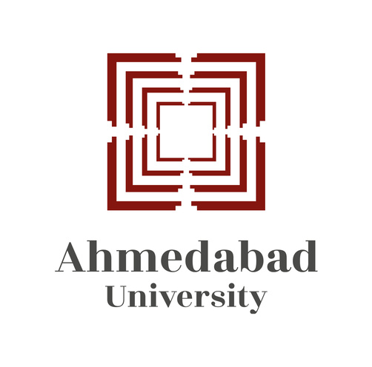
ENHANCING EFFICIENCY AND SOCIETAL IMPACT OF AHMEDABAD'S BRTS: INTERVENTIONS AND INNOVATIONS
Presented By : Rishika Agarwal

Slide 2
1
ABOUT ME
Currently pursuing Bachelors of Arts in Major Economics and Minor Mathematics from Ahmedabad University
Applied for Masters of Science in Business Analytics in University of Warwick, London
Have a interest in simulation modelling and Statistics

Slide 3
2
ABOUT MY RESEARCH
Research question: Examining the efficiency of Bus Rapid Transit Systems (BRTs) and how policies influence citizen behavior in relation to public transportation.
Through prioritizing efficient public transit options and enacting supportive policies, cities can significantly enhance their transportation systems, lessen environmental impact, expand accessibility, and foster a more livable urban environment.
This research aims to comprehend the impact of different policy interventions on ridership patterns, the shift from private cars to public transport, and the achievement of overall sustainability goals.

Slide 4
3
LITERATURE REVIEW
This research examines the implementation of electric BRTS in Mexico City, focusing on the operational, environmental, and economic aspects of the transition from private to public bus services (J. M. González-Ruiz et al., 2018).
This research illuminates the innovative approach adopted in Japan for the development of low-speed electric community buses aimed at revitalizing local areas. It underscores the importance of collaboration among various stakeholders to improve mobility options and cater to specific transportation needs within communities (Amagai, K. et al.).
This research primarily focuses on examining various facts of BRTS including their current design, capacity, ridership trends, integration with alternative transportation modes, and the challenges users encounter in accessing the system (Capacities India. (2020)).

Slide 5
4
INTRODUCTION
1
Each year, 127 million Indians use the BRTS. The Ahmedabad BRTS dominates this ridership, accounting for approximately 31% of total daily passengers.
2
The Ahmedabad BRTS (Janmarg) covers 160 kilometers with a daily ridership of 349,000 passengers and has received several awards for its efficient and sustainable design.
3
In terms of modal split, 22% of transport is public, 42% is private, and 36% is non-motorized(cycle, walk).
4
BRTS have two types: open corridors, which allow buses from multiple routes to use the corridors, and closed corridors, which restrict other routes or buses from entering the dedicated bus lanes.
Sources: Ahmedabad Janmarg Limited

Slide 6
5
METHODOLOGY
The research focuses on two aspects:
the utilization of Bus Rapid Transit Systems (BRTS) and the considerations for not utilizing BRTS
The study examines the impact of incentives on the performance of Bus Rapid Transit Systems (BRTS) and on the subsequent shift of individuals towards utilizing public transportation services.
Data is gathered through questionnaires distributed initially to the population of Ahmedabad University. The collected data is analyzed utilizing Statistical Package for the Social Sciences (SPSS) software.
The second stage of the process involves the analysis of data concerning the transition of individuals from private modes of transportation to public transportation utilizing Simulation for Urban Mobility (SUMO) software.

Slide 7
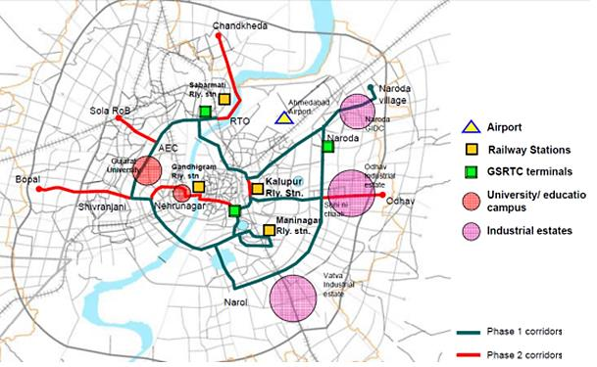
TRANSPORT EQUITY
6
Figure 4: BRTS routes
Source: “AHMEDABAD BRT NETWORK MAP IN PHASE WISE MANNER BRT Stations
“ResearchGate

Slide 8
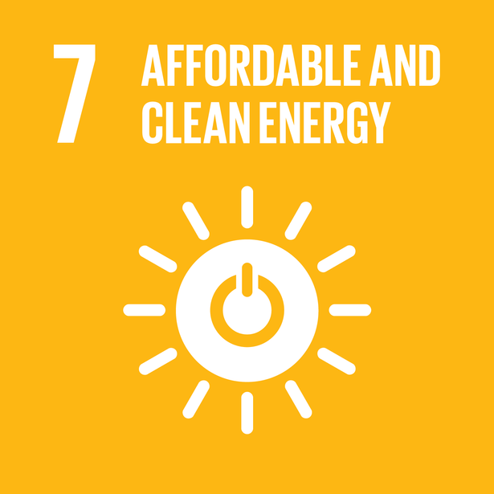
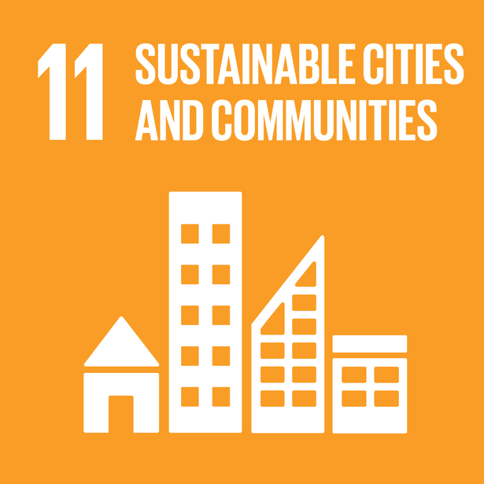
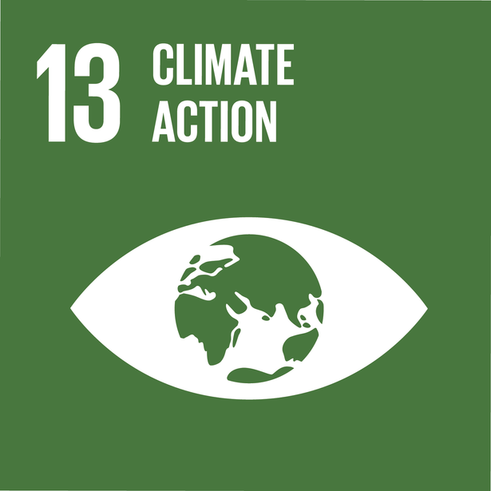
CARBON EMISSIONS
7
A long-term view of a BRTS would include its integration with the land use plan and housing policy of a city for equitable accessibility and reducing travel distances, thereby reducing carbon emissions (Mahadevia. D., et.al, 2013).
BRTS can save a large amount of money when compared to individual motorized transportation such as private passenger automobiles.
As compared to a diesel baseline vehicle, utilizing any of the advanced BRT technology choices would dramatically cut emissions at a low additional cost
Figure 1: SDG 7
Source: “Sustainable Development Goal 7:
Affordable and Clean Energy” UNOOSA
Figure 2: SDG 11
Source: “Sustainable Development Goal 11: Sustainable Cities and Communities”UNOOSA
Figure 3: SDG 13
Source: “Sustainable Development Goal 13:
Climate Action” UNOOSA

Slide 9
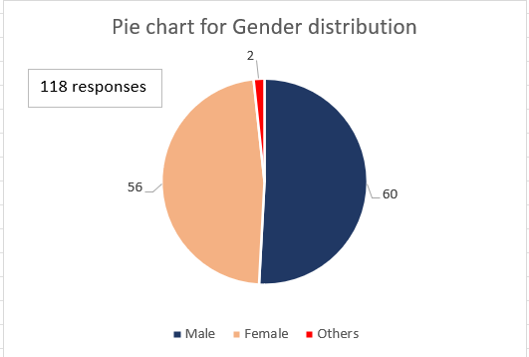
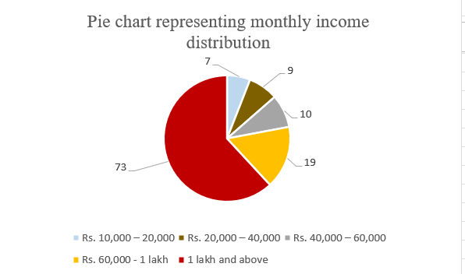
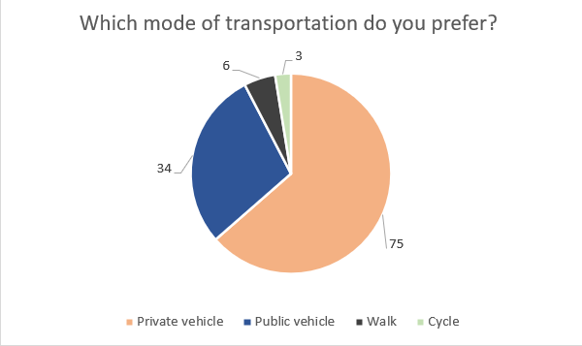
ANALYSIS OF THE SURVEY
8

Slide 10
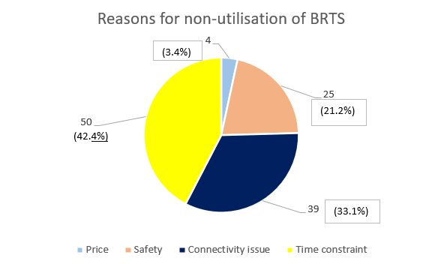
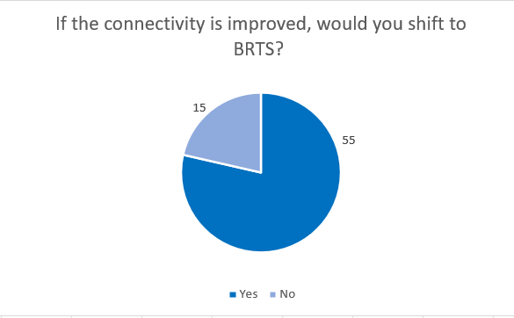
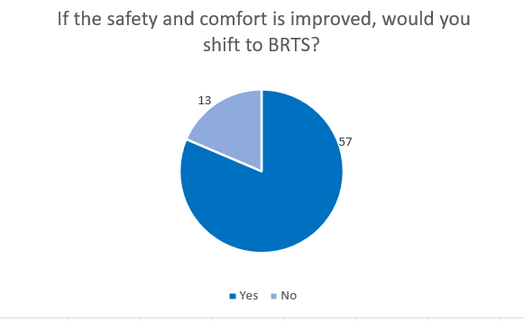
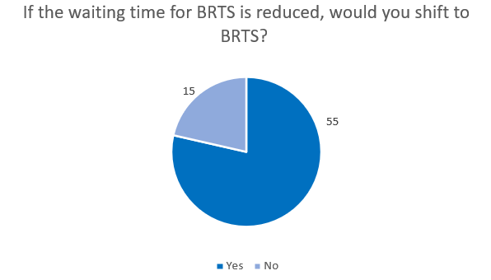
ANALYSIS OF THE SURVEY
9

Slide 11
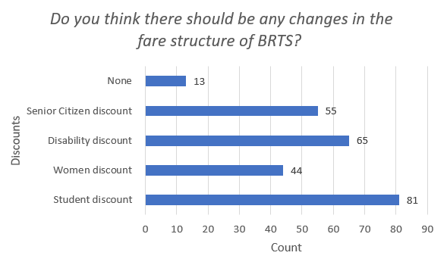
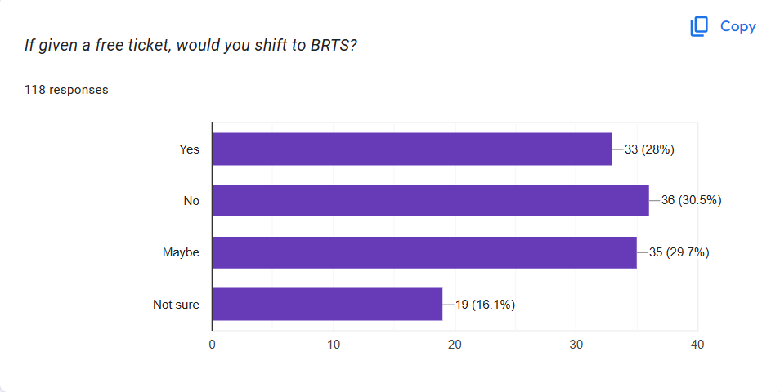
ANALYSIS OF THE SURVEY
10

Slide 12
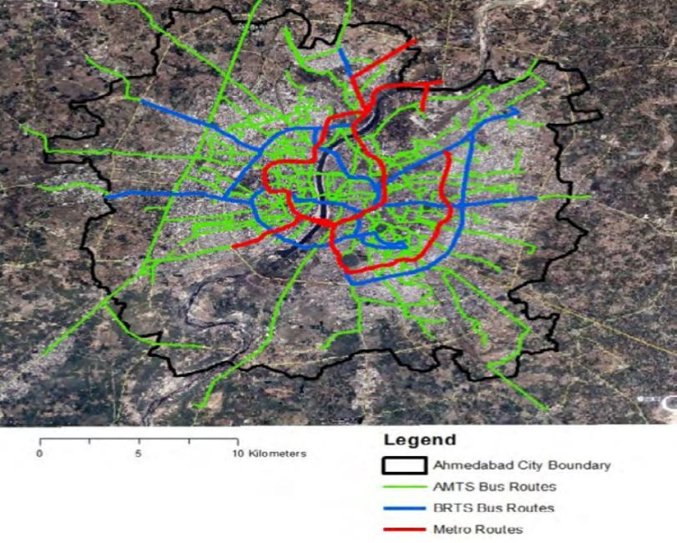
AMTS, BRTS AND METRO ROUTES
11
Figure 4: AMTS, BRTS and metro routes
Source: Shah, J. S., & Adhvaryu, B. (2016). Public transport accessibility levels for Ahmedabad, India. Journal of Public Transportation.

Slide 13

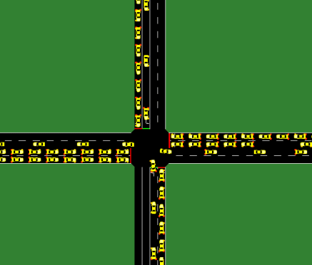
12
SUMO (SIMULATION OF URBAN MOBILITY)
Simulation of Urban Mobility (SUMO) is an open source and continuous traffic simulation package designed to handle large networks.
Main features in SUMO include multimodal traffic, network import and traffic lights.
The heterogeneous traffic environment in India poses unique challenges but by a research in IIT Bombay by utilizing SUMO they were able to create virtual environments that closely resembled real-world traffic conditions in Indian cities (Sashank, Y., et al. (2020).
Figure 4: SUMO
Source: “SUMO software logo” Github
Figure 5: SUMO example
Source: “SUMO simple example” ResearchGate

Slide 14
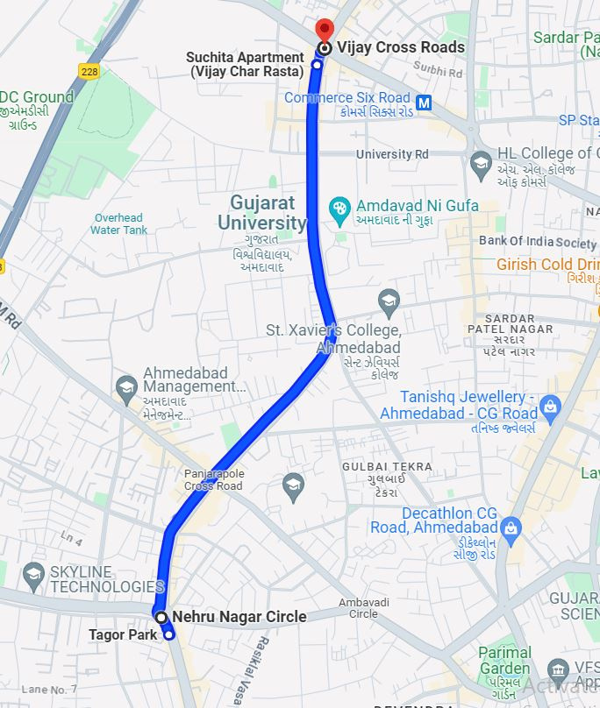
STUDY AREA
13
Figure 6: Map of Study Area
Source: Google Maps

Slide 15


14
SIMULATION
Create a Map
Convert the network from osm to net
Upload the network in SUMO
Make sure all the roads are linked and connected
Run the simulation and get results
create a route for all vehicles
Add traffic signal time
Bus stops are created (AMTS, BRTS)
OSM -Open Street Map

Slide 16
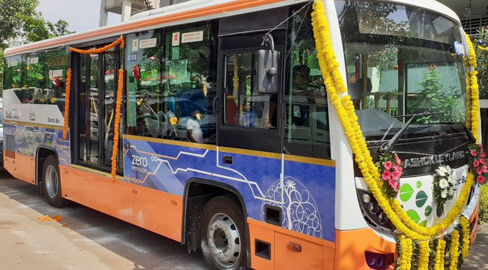
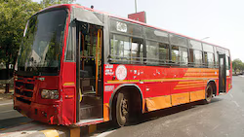
CASES
15
Case No. | Description | No. of cars | No. of AMTS | No. of BRTS
Case 1 | Present scenario | 40 | 3 | 3
Case 2 | Converting AMTS passengers to BRTS passengers | 40 | - | 6
Case 3 | Converting private transportation to public transportation | 20 | 3 | 6
Case 4 | A slight punishment for private vehicles | 20 | 3 | 6
Figure 7: Electric bus
Source: “ BRTS in Ahmedabad.” DeshGujarat
Figure 8: AMTS bus
Source: “AMTS Bus in Ahmedabad.” DNA India

Slide 17


16
VARIABLE OF INTEREST
Signal time (s)
Speed (m/s)
(Red, Green) | Car | AMTS | BRTS
Case 1
Case 2 |  | -
Case 3
Case 4
(Red, Green) | Car | AMTS | BRTS
Case 1 | 12.5 | 11.1 | 14.4
Case 2 | 13.8 | - | 14.4
Case 3 | 13.8 | 11.1 | 14.4
Case 4 | 12.5 | 11.1 | 14.4
90
30
90
30
30
10
90
30
20
40
90
30
90
30
20
40
120
40
120
40
20
40

Slide 18
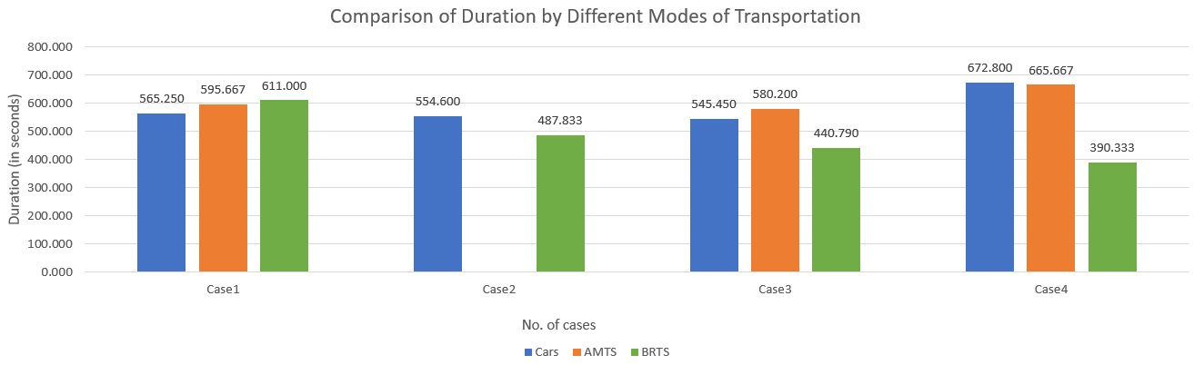
17
SIMULATION RESULTS
Duration time

Slide 19
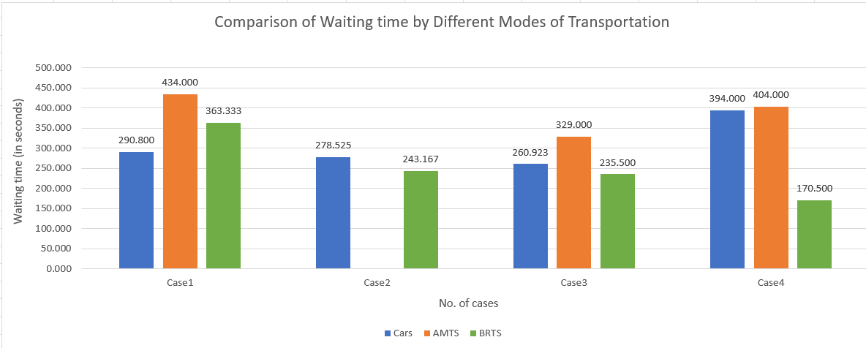
SIMULATION RESULTS
18
Waiting time

Slide 20
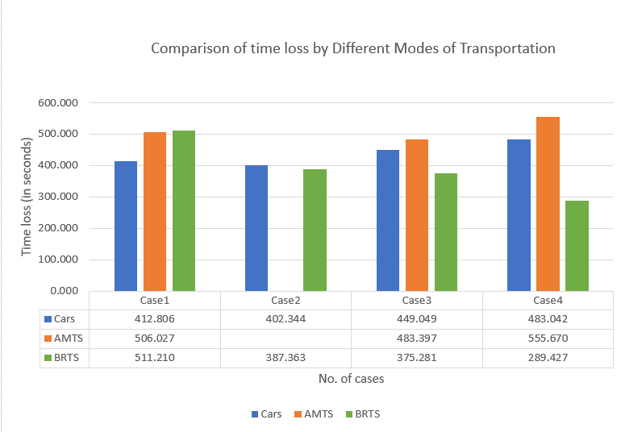
19
SIMULATION RESULTS
Time loss

Slide 21
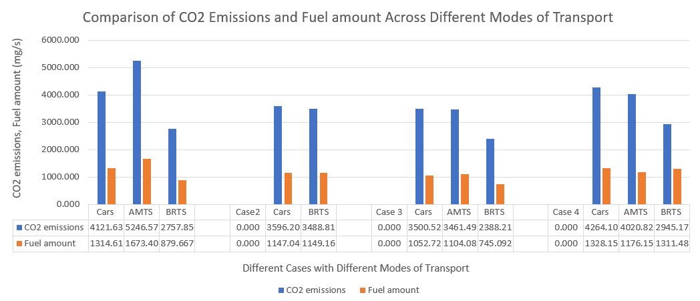
EMISSIONS
20
CO2 emissions and Fuel amount

Slide 22
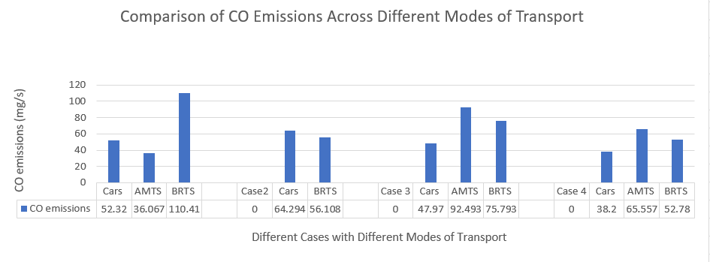
21
EMISSIONS
CO emissions

Slide 23
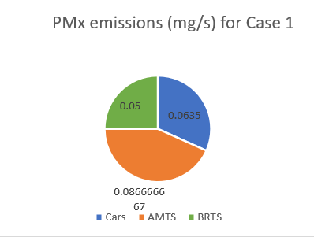
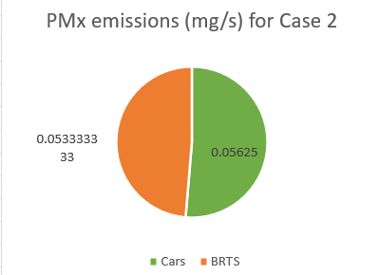
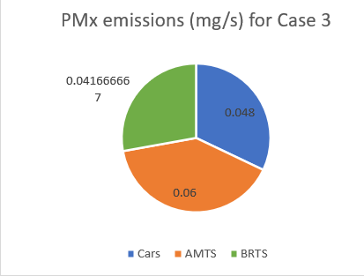
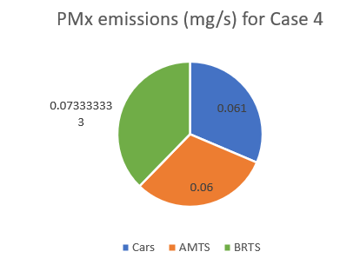
EMISSIONS
22
PMx emissions

Slide 24
FUTURISTIC PLANS
23
Case No. | Description | No. of cars | No. of Electric AMTS | No. of BRTS
Case 5 | Conversion of AMTS to Electric AMTS | 40 | 3 | 3
Case 6 | Conversion of BRTS Passengers to AMTS Passengers | 40 | 6 | -
Signal Time
Speed
Case No. | Cars | Electric Bus | BRTS
Case 5
Case 6 |  |  | -
Case No. | Cars | Electric Bus | BRTS
Case 5 | 12.5 | 11.1 | 14.4
Case 6 | 12.5 | 11.1 | -
90
30
90
30
30
10
90
30
90
30

Slide 25
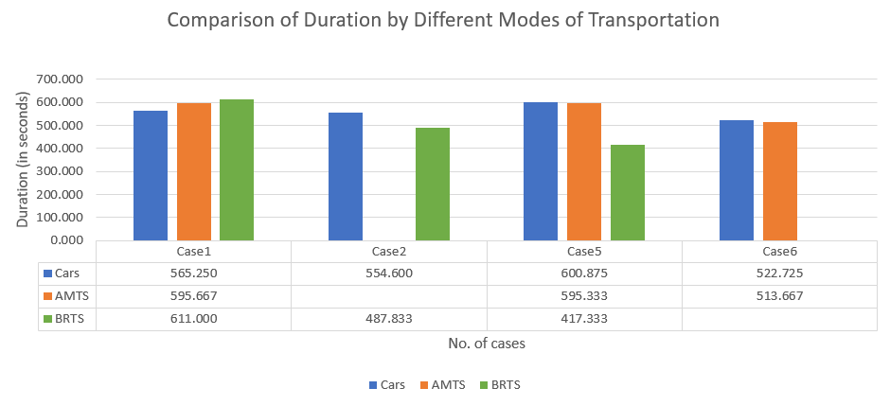
FUTURISTIC PLAN
24
Duration time

Slide 26
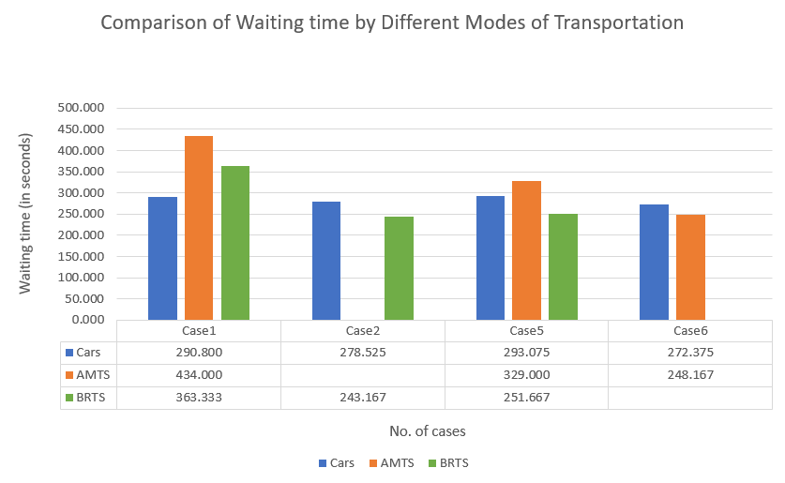
FUTURISTIC PLAN
25
Waiting time

Slide 27
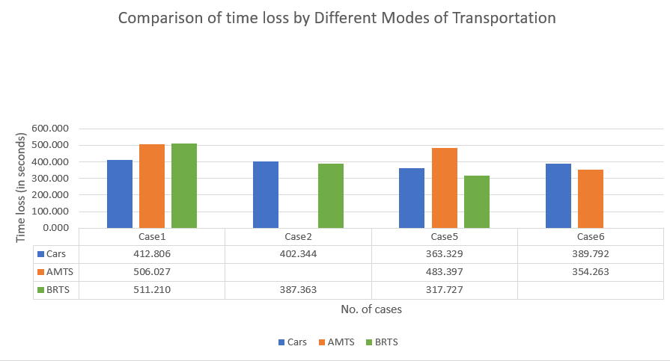
FUTURISTIC PLAN
26
Time loss

Slide 28
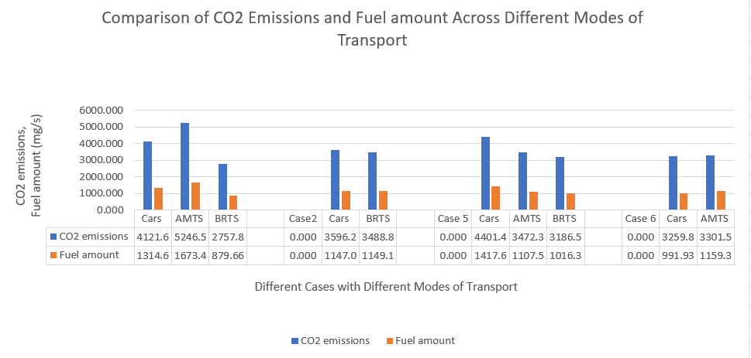
EMISSIONS
27
CO2 emissions and Fuel amount

Slide 29
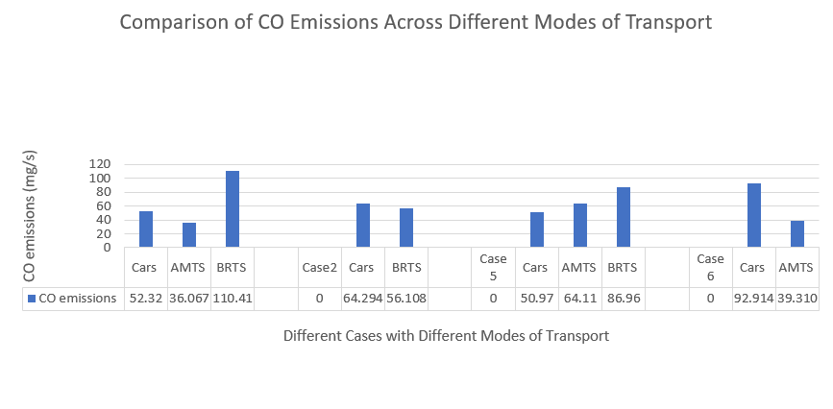
EMISSIONS
28
CO emissions

Slide 30
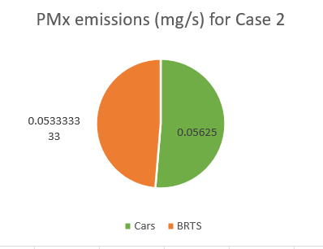
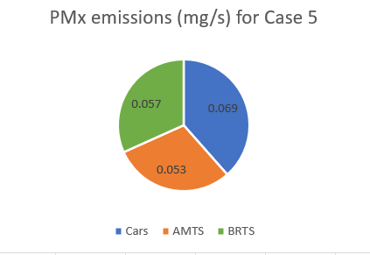
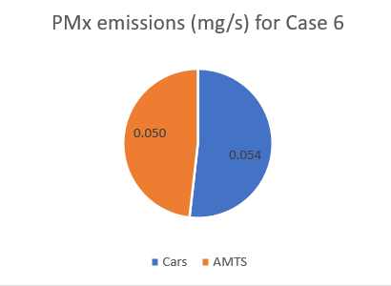
EMISSIONS
29
PMx emissions

Slide 31
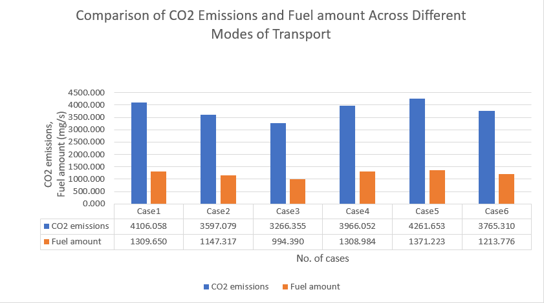
EMISSIONS
30
Overall emissions

Slide 32



31
SIMULATION CONCLUSION
Case 2 represents the optimal choice among all the presented cases.
Implementing a modest penalty on private vehicles could serve as an incentive for individuals to transition towards utilizing public transportation.
The ongoing transition of the Ahmedabad Municipal Transport Service (AMTS) to electric vehicles suggests that amalgamating AMTS with the Bus Rapid Transit System (BRTS) could yield significant positive impacts on both the environment and society.
Cost saving
Environmental Saving
Societal Benefits
Sources:iStock

Slide 33
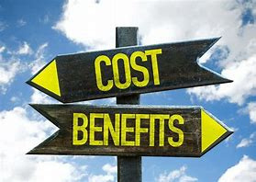
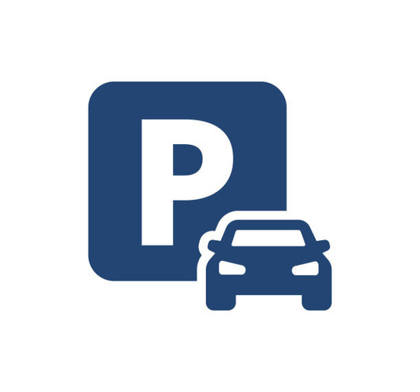


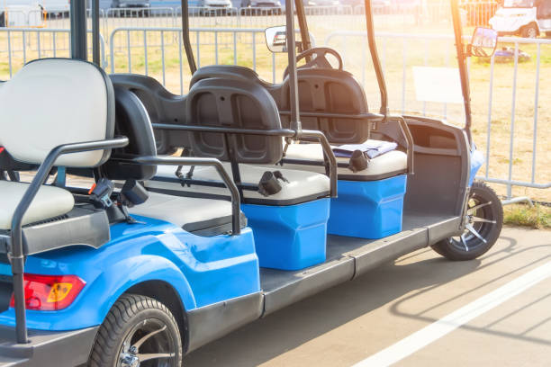
POLICY IMPLEMENTATION
32
Cost V/S Benefit
2. Parking
3. Discounts
Sources:iStock
4. Societal Issues
5. Electric Cart/Rickshaw

Slide 34
33
REFERNCES
Amagai, K., Kotake, H., Munemura, M., Shigeto, S., & Horio, M. (Year). Co-development of Low-speed Electric Community Buses for Local Area Revitalization. https://www.researchgate.net/publication/368228797_Co-development_of_Low-speed_Electric_Community_Buses_for_Local_Area_RevitalizationGonzález-Ruiz, J. M.,
Capacities India. (2020). Rajkot Final Report. https://www.capacitiesindia.org/wp-content/uploads/2020/11/Rajkot-Final-Report-_Vs.pdf
García-Palacios, A., & Martínez-López, J. M. (2018). Electric bus rapid transit: A case study of Mexico City. Transportation Research Part D: Transport and Environment. https://cdn.intechopen.com/pdfs/52783.pdf
Mahadevia, D., Joshi, R., & Datey, A. (2013, November 30). Ahmedabad’s BRT system: A sustainable urban transport panacea? ResearchGate. https://www.researchgate.net/publication/259289231_Ahmedabad’s_BRT_system_A_sustainable_urban_transport_panacea
Sashank, Y., Kulkarni, P., & Rao, N. V. (2020). Creating Realistic Virtual Environments for Traffic Simulation: A Case Study of Indian Cities. In Proceedings of the IEEE Intelligent Transportation Systems Conference (ITSC), 2020. https://www.researchgate.net/publication/349357096_Virtual_Simulations_Environment_Development_for_Autonomous_Vehicles_Interaction

Slide 35
THANK YOU
Presented By : Rishika Agarwal

